Slide 1
Decision Trees for Classification

Slide 2
In many fields, large collections of examples, possibly collected for other purposes, are readily available. Automatically generating classification rules (often called decision rules) for such tasks has proved to be a realistic alternative to the standard Expert System approach of eliciting the rules from experts.
The aim is to develop classification rules from the data in the training set. This is often done in the implicit form of a decision tree.

Slide 3
A decision tree is created by a process known as splitting on the value of attributes i.e. testing the value of an attribute and then creating a branch for each of its possible values.
In the case of continuous attributes the test is normally whether the value is ‘less than or equal to’ or ‘greater than’ a given value known as the split value.
The splitting process continues until each branch can be labelled with just one classification.

Slide 4
Training set and Decision tree are equivalent in the sense that for each of the instances the given values of all attributes in the training set will lead to the identical classifications.
Decision trees have two different functions: data compression and prediction.
It is important to stress that this ‘decision’ is only a prediction, which may or may not turn out to be correct.

Slide 5
Decision tree consists of a number of branches, each ending with a leaf node labelled with one of the valid classifications.
Each branch comprises the route from the root node (i.e. the top of the tree) to a leaf node.
A node that is neither the root nor a leaf node is called an internal node.

Slide 6
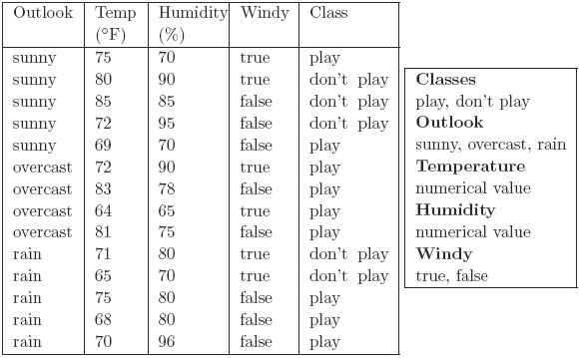
A fictitious example is that of a golfer who decides whether or not to play each day on the basis of the weather.
It shows the results of two weeks (14 days) of observations of weather conditions and the decision on whether or not to play.

Slide 7
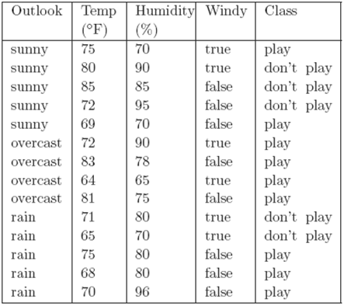
If tomorrow the values of Outlook, Temperature, Humidity and Windy were sunny, 74◦F, 77% and false respectively, what would the decision be?
One way of answering this is to construct a decision tree.

Slide 8
In order to determine the decision (classification) for a given set of weather conditions from the decision tree, first look at the value of Outlook. There are three possibilities.

Slide 9
If the value of Outlook is sunny, next consider the value of Humidity. If the value is less than or equal to 75 the decision is play. Otherwise, the decision is don’t play.
If the value of Outlook is overcast, the decision is play.
If the value of Outlook is rain, next consider the value of Windy. If the value is true the decision is don’t play, otherwise the decision is play.

Slide 10
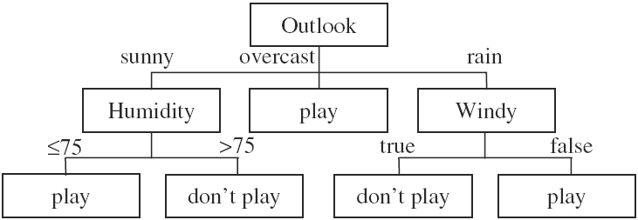
We call it a hypothetical decision tree.
Note that the value of Temperature is never used.
Notes:
Hypothetical tree

Slide 11
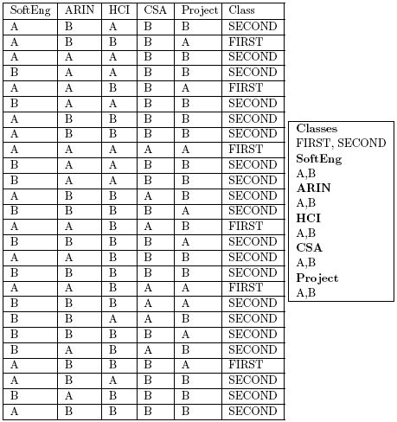
The degrees Dataset
The training set shown beside (taken from a fictitious university) shows the results of students for five subjects coded as SoftEng, ARIN, HCI, CSA and Project and their corresponding degree classifications, which in this simplified example are either FIRST or SECOND. There are 26 instances. What determines who is classified as FIRST or SECOND?

Slide 12
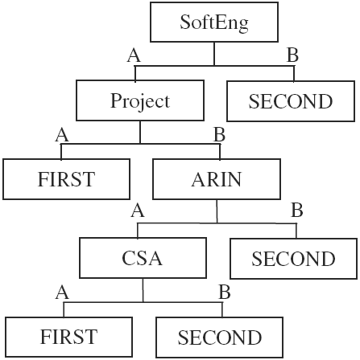
The degrees Dataset

Slide 13
The degrees Dataset
We can think of the root node as corresponding to the original training set. All other nodes correspond to a subset of the training set.
At the leaf nodes each instance in the subset has the same classification. There are five leaf nodes and hence five branches.

Slide 14
The degrees Dataset
Each branch corresponds to a classification rule. The five classification rules can be written in full as:
IF SoftEng = A AND Project = A THEN Class = FIRST
IF SoftEng = A AND Project = B AND ARIN = A AND CSA = A THEN Class = FIRST
IF SoftEng = A AND Project = B AND ARIN = A AND CSA = B THEN Class = SECOND
IF SoftEng = A AND Project = B AND ARIN = B THEN Class = SECOND
IF SoftEng = B THEN Class = SECOND

Slide 15
IF SoftEng = A AND Project = A THEN Class = FIRST
The left-hand side of each rule (known as the antecedent) comprises a number of terms joined by the logical AND operator.
Each term is a simple test on the value of a categorical attribute (e.g. SoftEng = A) or a continuous attribute (e.g. in Figure 3.2, Humidity > 75).
A set of rules of this kind is said to be in Disjunctive Normal Form (DNF). The individual rules are sometimes known as disjuncts.
The order in which we write the rules generated from a decision tree is arbitrary. We can rearrange the rules without any change to the predictions the ruleset will make on unseen instances.

Slide 16

Each instance in the original degrees training set could be viewed as a rule, for example IF SoftEng = A AND ARIN = B AND HCI = A AND CSA = B AND Project = B THEN Class = SECOND
There are 26 such rules, one per instance, each with five terms, making a total of 130 terms.
The decision tree can be written as five decision rules with a total of 14 terms, an average of 2.8 terms per rule.
Even for this very small training set, the reduction in the number of terms requiring to be stored from the training set (130 terms) to the decision tree (14 terms) is almost 90%.

Slide 17
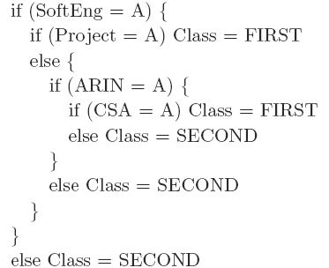
For practical use, the rules can easily be simplified to an equivalent nested set of IF . . . THEN . . . ELSE rules, with even more compression

Slide 18
TDIDT
Decision trees are widely used as a means of generating classification rules because of the existence of a simple but very powerful algorithm called TDIDT, which stands for Top-Down Induction of Decision Trees.
The method produces decision rules in the implicit form of a decision tree. Decision trees are generated by repeatedly splitting on the values of attributes. This process is known as recursive partitioning.

Slide 19
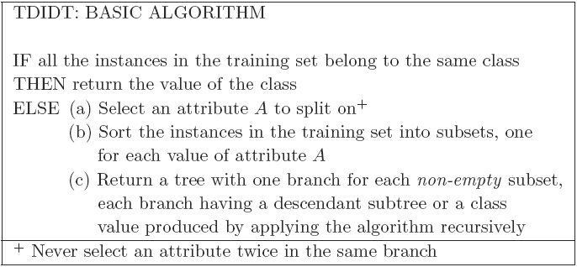
TDIDT

Slide 20
TDIDT
At each non-leaf node an attribute is chosen for splitting. This can potentially be any attribute, except that the same attribute must not be chosen twice in the same branch.
This restriction has a very valuable effect. Each split on the value of an attribute extends the length of the corresponding branch by one term, but the maximum possible length for a branch is M terms where there are M attributes. Hence the algorithm is guaranteed to terminate.
A major problem with the TDIDT algorithm, which is not apparent at first sight, is that it is underspecified. The algorithm specifies ‘Select an attribute A to split on’ but no method is given for doing this.

